Slide 1
Jenkins (Current) Architecture and workflow

Slide 2
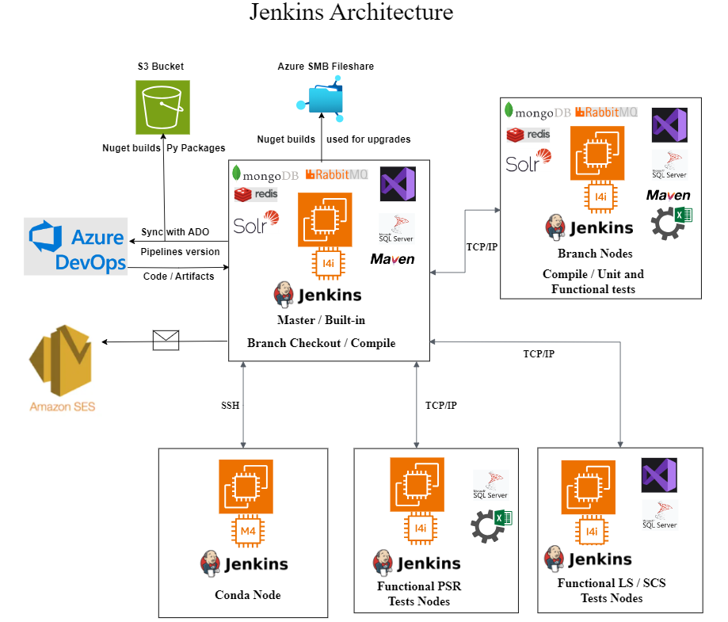

Slide 3
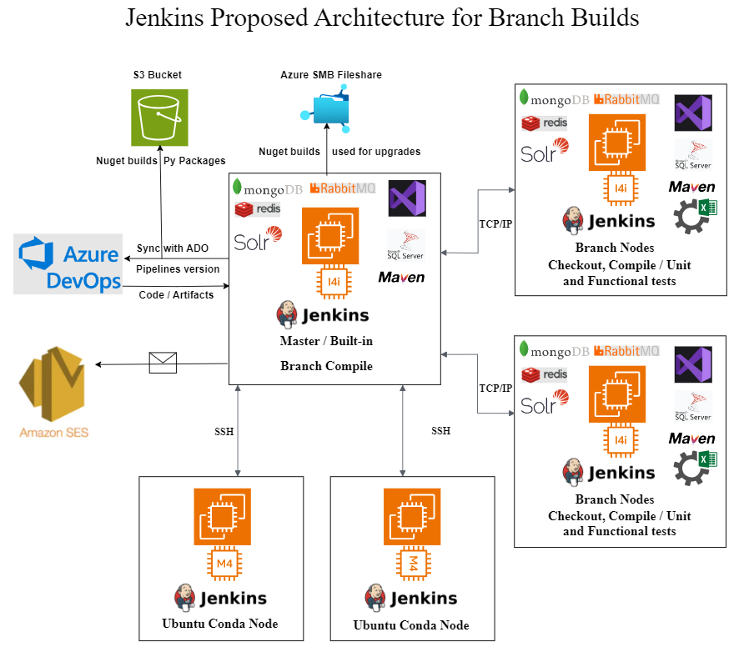

Slide 4
Action Items to reduce total time
Moving Git Checkout to different branch nodes -- Hari
Identifying the dependencies of compilation in the master and setting up the dependencies in the branch nodes -- Dev help required.
Conda nodes to be moved to Ubuntu --Hari
Single Compile for multiple solutions -- Vikram/Hari (In progress)
Split time-consuming Test jobs -- Dev help required.
Using 2 nodes for each branch suite -- Hari.

Slide 5
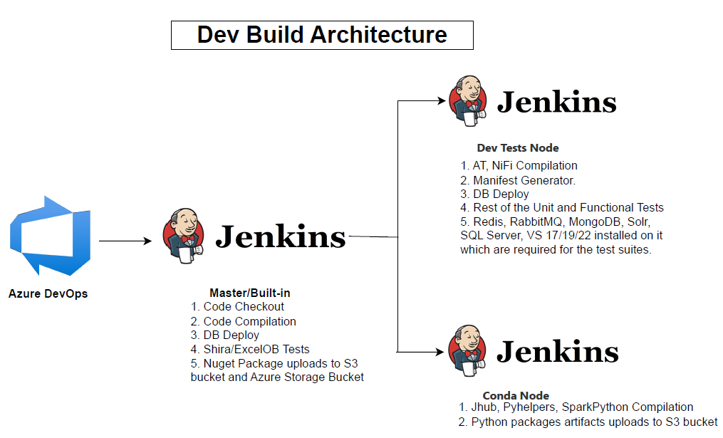

Slide 6
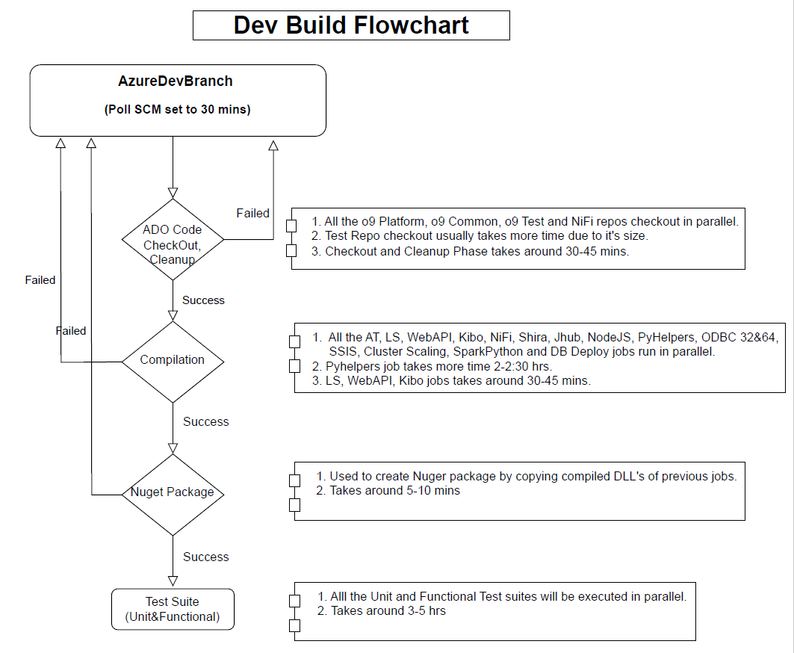

Slide 7
Jenkins Inventory
Jenkins Nodes List | Operating System | Core components installed | Total Count | Purpose
Master Built-in Node | Window 2016 | 1. VS 2017/19/22, 2. SQL Server 2016, 3. RMQ 3.7.5, 4. Redis 3.2, 5. MongoDB 4.4, 6. Solr 9.1.1, 7. Office 365 | 1 | 1. Jenkins Master connects with all the slave nodes and keeps all the admin data. 2. Code Checkout 3. Core Components Compilation 4. Nuget Creation
Branch Nodes | Window 2016, 2022 | 1. VS 2017/19/22, 2. SQL Server 2016, 3. RMQ 3.7.5, 4. Redis 3.2, 5. MongoDB 4.4, 6. Solr 9.1.1, 7. Office 365 | 6 | 1. To execute other components compile. 2. Branch level Unit and Functional test suites
LS SCS PSR | Window 2016, 2022 | VS 2017/19/22, SQL 2016, Office 365 | 15 | LS, SCS, PSR Excel test suites execution
LS SCS | Window 2016, 2022 | VS 2017/19/22, SQL 2016 | 6 | LS and SCS test suites execution
Conda Node | RHEL 7 &9 | Conda | 2 | Pyhelpers compile
Jmeter | Window 2019 | Jmeter | 1 | Jmeter Test suites
S3 Bucket | NA | NA | 2 | Used to store Nuget builds and Py Packages
Azure SMB FileShare | NA | NA | 1 | Used to store Nuget builds which will be used for environment upgrades

